Slide 1
Linear Algebra 线性代数
仝辉
tóng huī
Hui Tong

Slide 2
注意事项
课程QQ群号码 764940233，自愿实名加入，须提供姓名和10位学号。
有任何关于课程学习的问题，都可以通过QQ群或者Email联系。
Email地址：tonghui@bupt.edu.cn
课堂认真听讲，课后及时独立完成作业。
请尽量用 数学作业纸 写作业，交作业时 不要交作业本。
不要拖延学习进度，以免“欠账太多还不上”。

Slide 3
注意事项
如果上课迟到，直接进入教室找到座位坐下听讲即可。
注意低调。
课程总评成绩，由期末卷面成绩与平时成绩加权平均后得到。
平时成绩包括出勤成绩、作业成绩和课堂测验等。
线性代数词汇中英对照表
https://mp.weixin.qq.com/s/Vd6aJTtxtvnzyULvZJ-yDQ

Slide 4
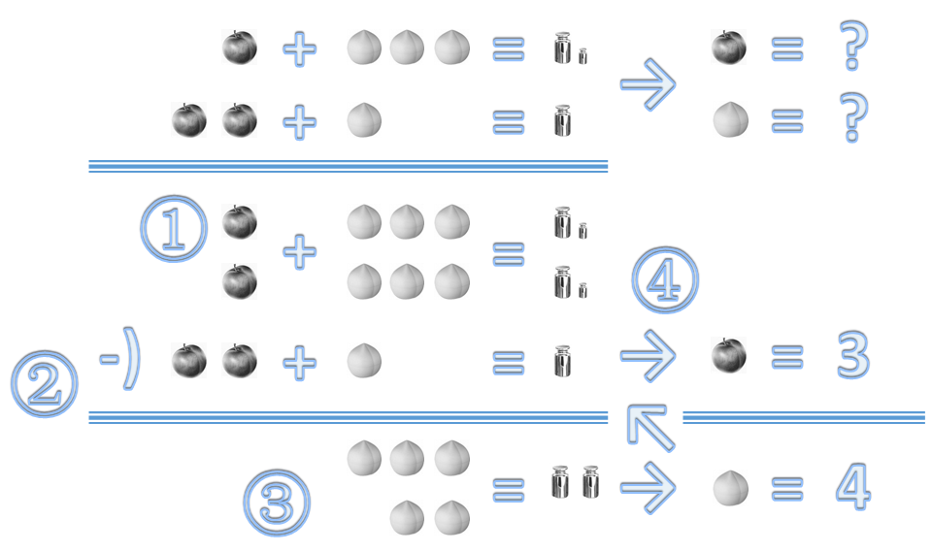

Example 例题
How to solve $\left\{\begin{matrix}x+3y=15 \\ 2x+y=10\end{matrix}\right.$ ?
$2x+6y=30$
$5y=20$
$y=4$
$2x=6$
$x=3$
Gaussian eliminination
高斯消元法

Slide 5
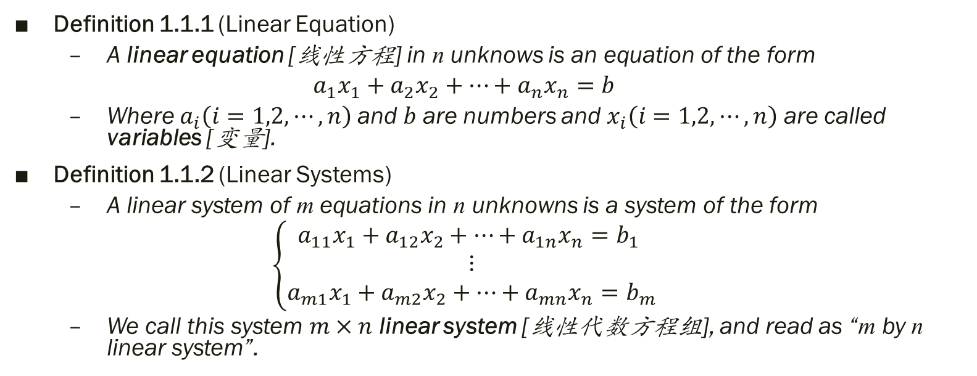
Definition 定义
Definition 1.1.1 (Linear Equation)
A linear equation [线性方程] in n unknows is an equation of the form
$$a_{1}x_{1}+a_{2}x_{2}+⋯+a_{n}x_{n}=b$$
Where $a_{i}\left(i=1,2,⋯,n\right)$ and $b$ are numbers and $x_{i}\left(i=1,2,⋯,n\right)$ are called variables [变量].
Definition 1.1.2 (Linear Systems)
A linear system of m equations in n unknowns is a system of the form
$$\left\{\begin{matrix}a_{11}x_{1}+a_{12}x_{2}+⋯+a_{1n}x_{n}=b_{1} \\ ⋮ \\ a_{m1}x_{1}+a_{m2}x_{2}+⋯+a_{mn}x_{n}=b_{m}\end{matrix}\right.$$
We call this system $m×n$ linear system [线性代数方程组], and read as “m by n linear system”.

Slide 6
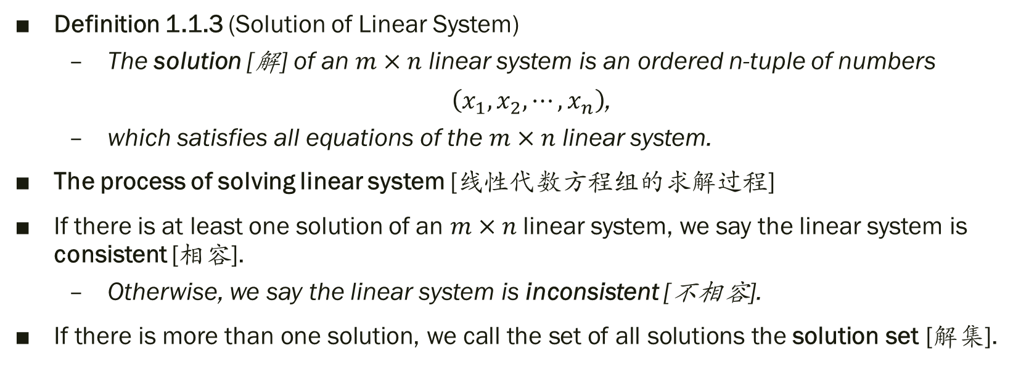
Definition 定义
Definition 1.1.3 (Solution of Linear System)
The solution [解] of an $m×n$ linear system is an ordered n-tuple of numbers
$\left(x_{1},x_{2},⋯,x_{n}\right)$,
which satisfies all equations of the $m×n$ linear system.
The process of solving linear system [线性代数方程组的求解过程]
If there is at least one solution of an $m×n$ linear system, we say the linear system is consistent [相容].
Otherwise, we say the linear system is inconsistent [不相容].
If there is more than one solution, we call the set of all solutions the solution set [解集].

Slide 7
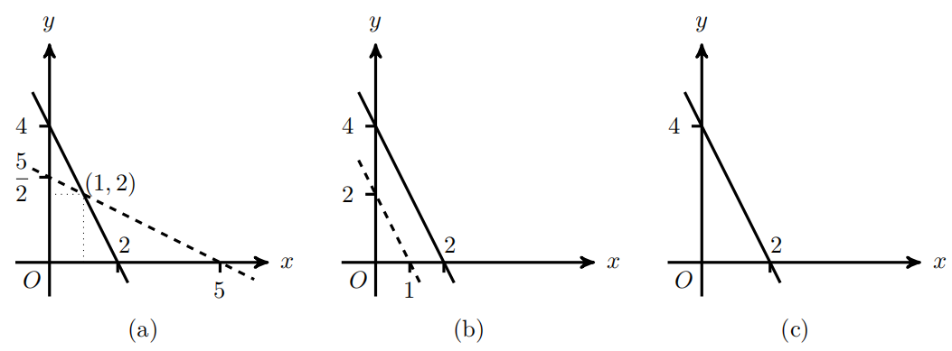

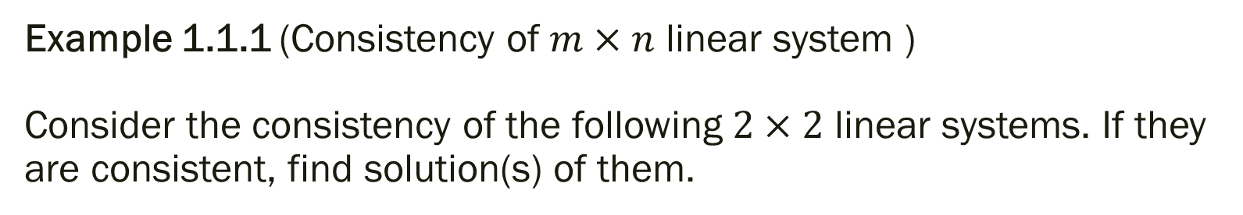
Example 1.1.1 (Consistency of $m×n$ linear system ) Consider the consistency of the following $2×2$ linear systems. If they are consistent, find solution(s) of them.
(a) $\left\{\begin{matrix}2x+y=4 \\ x+2y=5\end{matrix}\right.$
(b) $\left\{\begin{matrix}2x+y=4 \\ x+\frac{y}{2}=1\end{matrix}\right.$
(c) $\left\{\begin{matrix}2x+y=4 \\ 4x+2y=8\end{matrix}\right.$
(a) is consistent, with unique solution $\left(1,2\right)$; (b) is inconsistent; (c) is consistent, with infinite number of solutions $\left\{\left(α,−2α+4\right) | α is real number.\right\}$

Slide 8
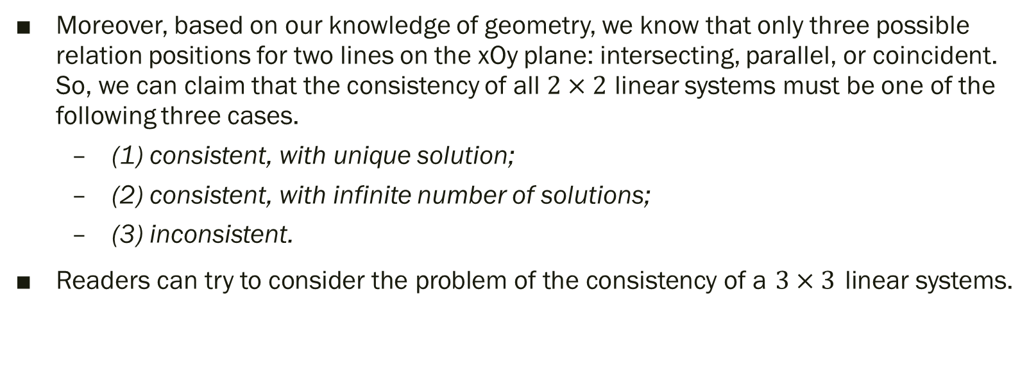
Moreover, based on our knowledge of geometry, we know that only three possible relation positions for two lines on the xOy plane: intersecting, parallel, or coincident. So, we can claim that the consistency of all $2×2$ linear systems must be one of the following three cases.
(1) consistent, with unique solution;
(2) consistent, with infinite number of solutions;
(3) inconsistent.
Readers can try to consider the problem of the consistency of a $3×3$ linear systems.

Slide 9
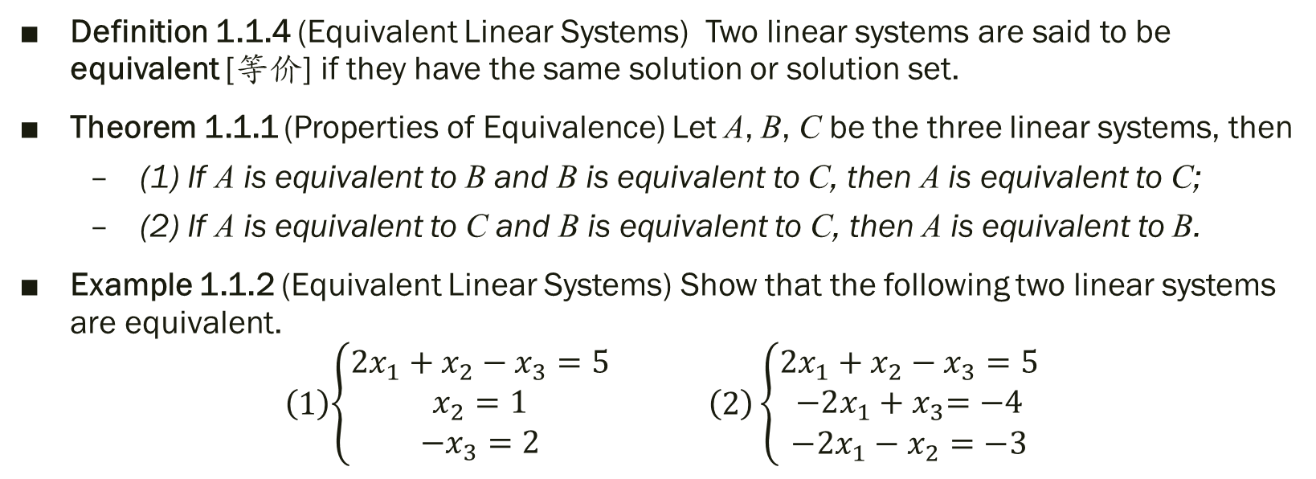
Equivalent Linear Systems 等价(同解)方程组
Definition 1.1.4 (Equivalent Linear Systems) Two linear systems are said to be equivalent [等价] if they have the same solution or solution set.
Theorem 1.1.1 (Properties of Equivalence) Let A, B, C be the three linear systems, then
(1) If A is equivalent to B and B is equivalent to C, then A is equivalent to C;
(2) If A is equivalent to C and B is equivalent to C, then A is equivalent to B.
Example 1.1.2 (Equivalent Linear Systems) Show that the following two linear systems are equivalent.
$$\left(1\right)\begin{matrix}\left\{\begin{aligned}2x_{1}+x_{2}−x_{3}=5 \\ x_{2}=1 \\ −x_{3}=2\end{aligned}\right. & & \left(2\right)\end{matrix}\left\{\begin{aligned}2x_{1}+x_{2}−x_{3}=5 \\ {−2x_{1}+x}_{3}=−4 \\ −2x_{1}−x_{2}=−3\end{aligned}\right.$$

Slide 10
Theorem 1.1.2 [定理1.1.2] Operations to Obtain Equivalent Linear Systems
There are three basic operations involved in equivalently changing a linear system into another linear system,
(1) interchanging the written order of two equations of a linear system does not change the solution set;
(2) multiplying both sides of an equation of a linear system by a nonzero real number does not change the solution set;
(3) replacing an equation of a linear system by a product of other equation added with the equation does not change the solution set.
Operations listed in Theorem 1.1.2 are generally used to derive a linear system, which is easy to be solved, from a linear system, equivalently.

Slide 11
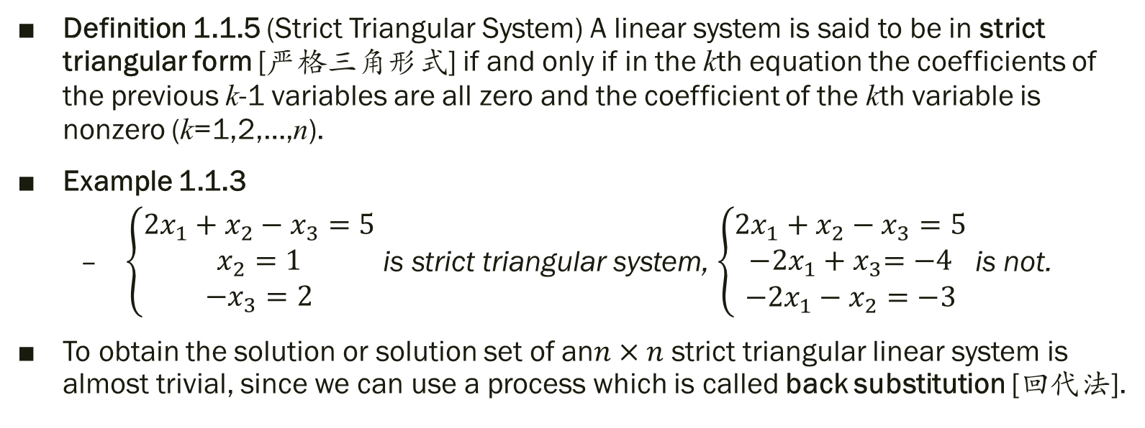
Strict Triangular Form of Linear Systems
Definition 1.1.5 (Strict Triangular System) A linear system is said to be in strict triangular form [严格三角形式] if and only if in the kth equation the coefficients of the previous k-1 variables are all zero and the coefficient of the kth variable is nonzero (k=1,2,…,n).
Example 1.1.3
$\left\{\begin{aligned}2x_{1}+x_{2}−x_{3}=5 \\ x_{2}=1 \\ −x_{3}=2\end{aligned}\right.$ is strict triangular system, $\left\{\begin{aligned}2x_{1}+x_{2}−x_{3}=5 \\ {−2x_{1}+x}_{3}=−4 \\ −2x_{1}−x_{2}=−3\end{aligned}\right.$ is not.
To obtain the solution or solution set of an$n×n$ strict triangular linear system is almost trivial, since we can use a process which is called back substitution [回代法].

Slide 12
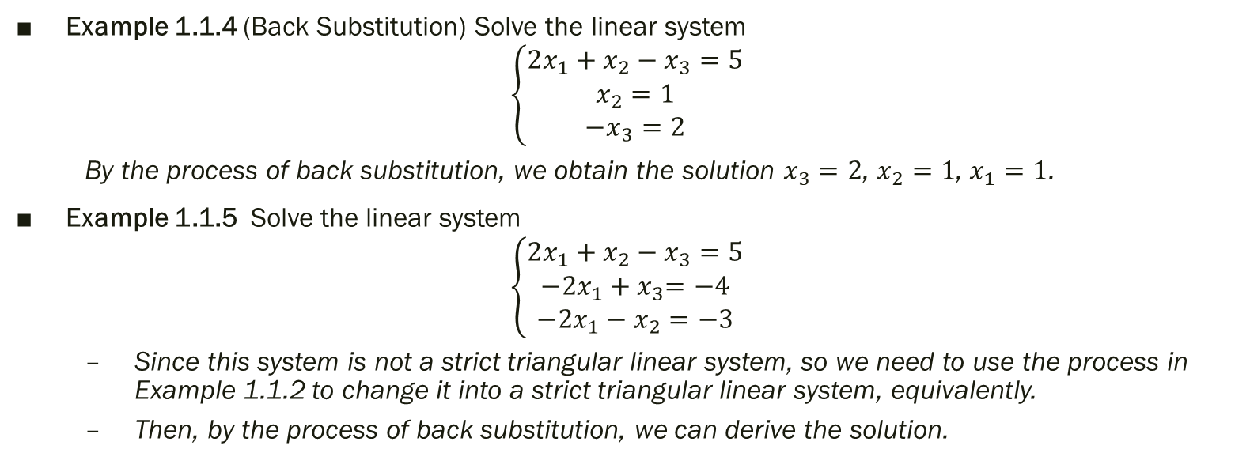
Solving Linear Systems —— Strict Triangular Form or NOT
Example 1.1.4 (Back Substitution) Solve the linear system
$$\left\{\begin{aligned}2x_{1}+x_{2}−x_{3}=5 \\ x_{2}=1 \\ −x_{3}=2\end{aligned}\right.$$
By the process of back substitution, we obtain the solution $x_{3}=2$, $x_{2}=1$, $x_{1}=1$.
Example 1.1.5 Solve the linear system
$$\left\{\begin{aligned}2x_{1}+x_{2}−x_{3}=5 \\ {−2x_{1}+x}_{3}=−4 \\ −2x_{1}−x_{2}=−3\end{aligned}\right.$$
Since this system is not a strict triangular linear system, so we need to use the process in Example 1.1.2 to change it into a strict triangular linear system, equivalently.
Then, by the process of back substitution, we can derive the solution.

